Slide 1


INFO H – I590 : Intro to Statistics in R (Project)
Super Store Data Analysis
By : Amritha Prakash
Notes:
Use of statistics to help us understand natural phenomena of Superstore data, As data is uncertain window into Nature. we can never gain a perfect and complete view of any phenomenon, Hence one could say statistical analysis is never complete — there are always more questions to ask.

Slide 2
Index
Purpose of analysis
Data Documentation
Exploratory Data Analysis
Trend (Time Series Analysis)
Hypothesis
Conclusion
Notes:
These are few things that I will cover inorder to make the process effective and helpful for the stakeholders

Slide 3
Purpose of Analysis
Analyzing superstore data serves several purposes, and businesses engage in this practice to gain insights, make informed decisions, and optimize their operations.
Improving Sales and Revenue
Enhancing Customer Experience
Competitive Analysis between Categories
Supply Chain Optimization
Market Basket Analysis
Risk Management
Notes:
help spot trends early in the study, and one can then focus their area of research properly

Slide 4

Focus through this project : To Increase Sales > to identify effective strategies to boost sales in a specific state, say state where the highest orders were placed. > to evaluate the company's sales over the years for the state and determines if any necessary changes are needed to enhance the sales performance. > to determine if different regions say East and West significantly influence sales trends and if the average sales for different Regions is consistent.
Notes:
> to determine if different categories significantly influence sales trends and if the average sales for different categories is consistent.

Slide 5

Data Documentation
Dataset is a US Super Store Data for the years starting from 2014 – 2017.
It contains a lot of features, about 21. But a few of them that would be used as per the goal are – i . State ii. Sales iii. Region iv. Category
They play a significant role to analyze and visualize the orders placed in the Store.
To understand Data better, we can ask few questions.
Notes:
It contained data which could answer the following questions – > Which Products were bought most frequently? > What Category do those Products fall into ? >

Slide 6
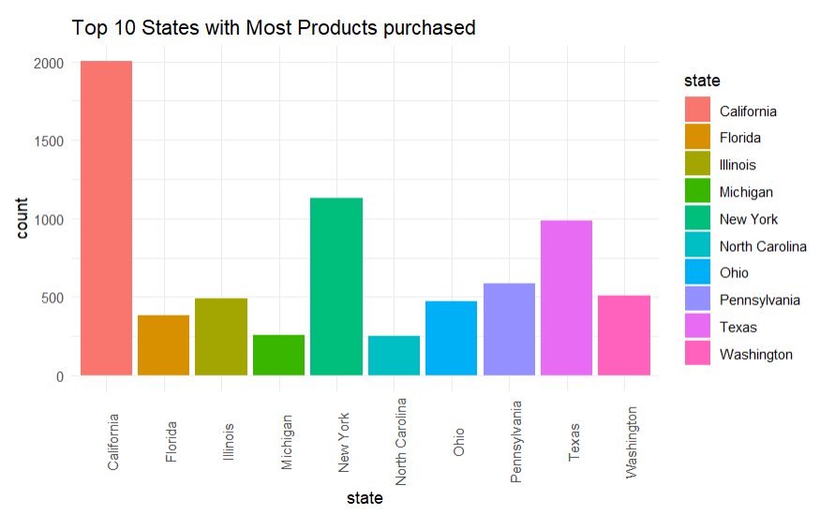
Exploratory Data Analysis
which are the top 10 states that have purchased the products from the Superstore over the years 2014 - 2017?

Slide 7
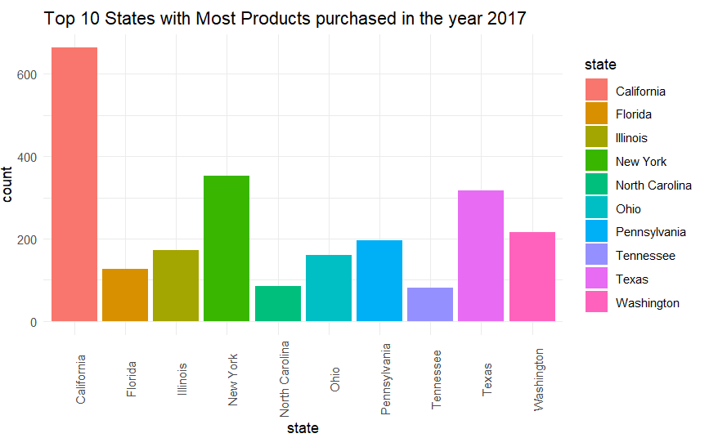
Exploratory Data Analysis
For 2017 alone, which are the top 10 states that have purchased the products?

Slide 8
Irrespective of the year, we can see that the orders placed in California is the largest.
Check if any strategies were put in play ?
In order to check the same, we can ask the following question -

Slide 9
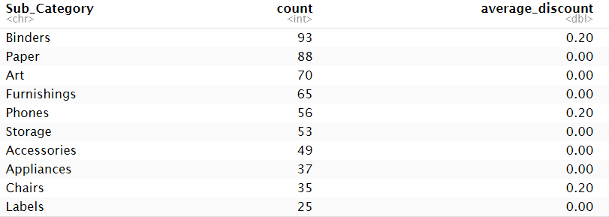
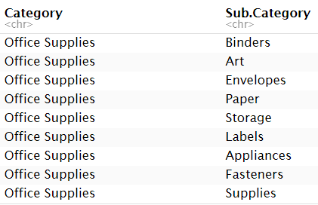
Exploratory Data Analysis
Which sub-category of products were bought the most in California and what was the average discount for those?
Which Category do these most purchased products lie in?

Slide 10
In case of California – All the products bought are office supplies. This indicates, maybe there was no marketing, and it was indeed need of the hour, as there a lot of Tech-based companies. Further, Better discounts and marketing can maybe increase sales in California and other western Tech based regions.
Notes:
Next slide - Further can look at the trend sales of california

Slide 11
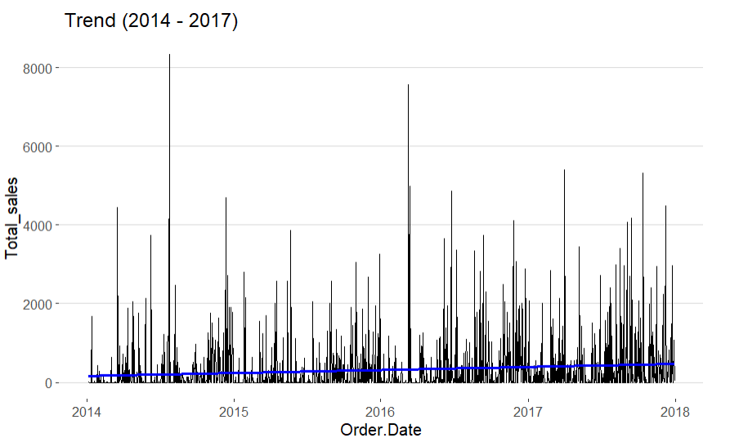
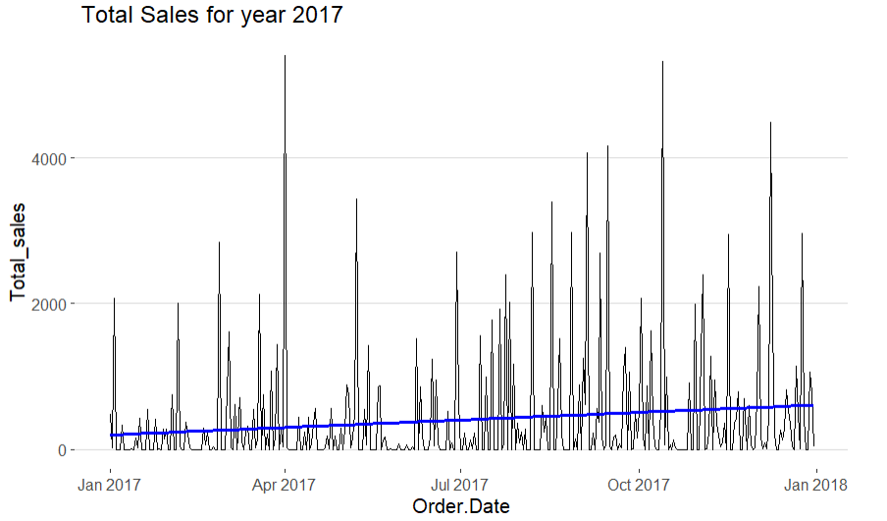
Trend in California
Also, to understand how the business is doing over time, plotted the Trend of Orders placed with time (2014 - 2017)
Conclusion: – Sales gradually Increasing over time. - Continue with current ways of promoting the products.
Notes:
That would help them grow more in the coming years. But for drastic growth as mentioned earlier it would be good to add discounts on products and strategise accordingly.

Slide 12
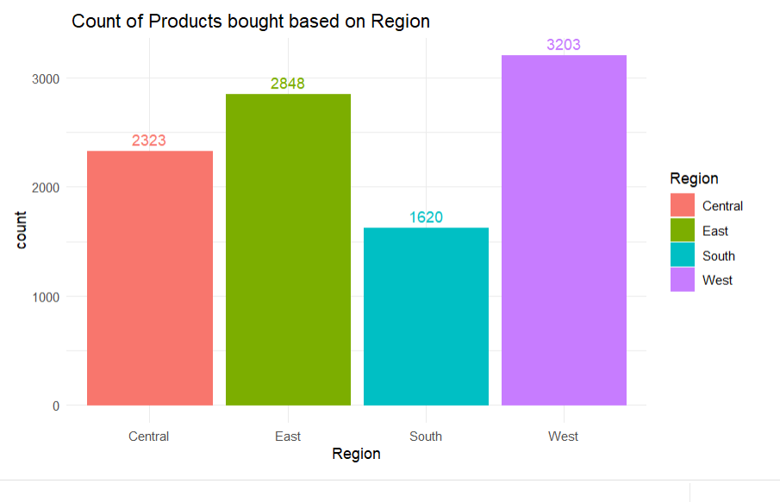
Exploratory Data Analysis
Is there any region wise trend in how products are bought?
Notes:
Further since we are looking to California which is from west of US, hence the question - From above plot, we can see that the orders placed in western and eastern region to be somewhat Higher compared to other regions. So we can put up a Hypothesis that Total Average sales in both western and eastern regions can be similar

Slide 13
Hypothesis Average Total Sales of Western region = Average Total Sales of Eastern region.
So we can put up a Hypothesis that Total Average sales in both western and eastern regions can be similar.
As per the Test, we found that it is true and accept the hypothesis. The Eastern and Western regions should be treated similarly in product sales, implementing marketing influences from the Western region and considering them as a single region.
The same can be plotted to be found similar
Notes:
Both are blooming in tech-based companies.

Slide 14
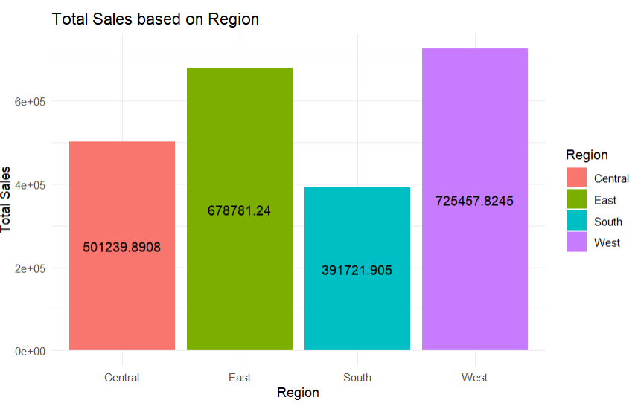
Exploratory Data Analysis
For each region, what has been the Total Sales for the Orders placed?
Notes:
Further can look into assumption that categories don’t play a significant role and they can be generalized in regard with sale. This can be done through testing the hypothesis as

Slide 15
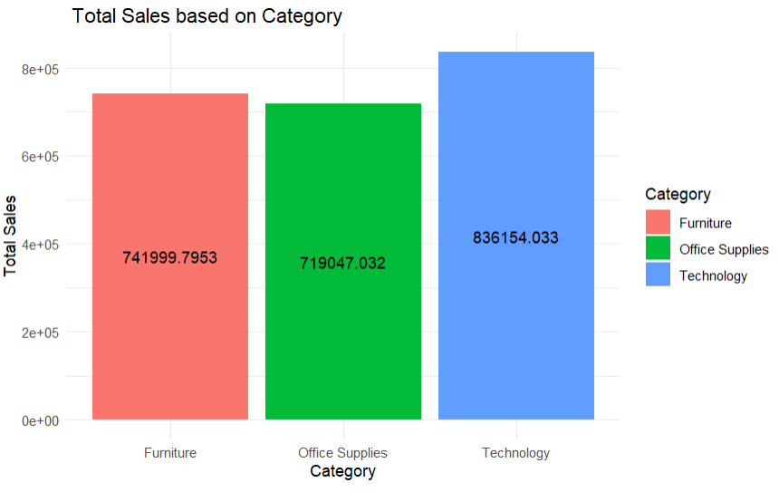
Exploratory Data Analysis
which category of products had most sales ?

Slide 16
Hypothesis : Average Total Sales of Technology = Average Total Sales of Office Supplies.
From above plot, we can see that the total sales for Technology and Office Supplies are somewhat similar
So, we can put up a Hypothesis that Total Average sales in both categories to be similar.
As per the Test, we found that it is False and Rejected the hypothesis. The Technology and Office Supplies play a significant role in determining the sales and hence are 2 separate categories.
we cannot generalize them to say that the average of each category is same. Hence business must take utmost care when strategizing on how to sell those products.
Notes:
P VALUE IS VERY SMALL – Reject the hypothesis The reason for picking Technology and Office Supplies are - * Technology is widely being used by everyone all around the world (digital world). * Furniture as a lot of people are investing to buy homes/ start Offices.
Demand for those categories wouldn’t go away in long run.

Slide 17
Conclusion
Consider promoting products in California, especially office supplies, to attract tech-focused clients; if the current strategy is successful, maintain it, but explore discounts on slow sales days for overall growth.
The increasing trend in total sales in California suggests continuing the current marketing strategy, which has not negatively impacted sales or profits over the years; explore occasional discounts for additional sales growth.
Accepting the Null Hypothesis for Western and Eastern regions indicates similar sales patterns, supporting a unified marketing approach; treating both regions as a single entity encourages streamlined business strategies for efficiency.
Statistical evidence emphasizes the significance of each product category in total sales, urging careful consideration of regional needs; marketing strategies should be tailored based on the importance of specific categories in different regions.

Slide 18
Conclusion
Consider promoting products in California, especially office supplies, to attract tech-focused clients; if the current strategy is successful, maintain it, but explore discounts on slow sales days for overall growth.
The increasing trend in total sales in California suggests continuing the current marketing strategy, which has not negatively impacted sales or profits over the years; explore occasional discounts for additional sales growth.
Accepting the Null Hypothesis for Western and Eastern regions indicates similar sales patterns, supporting a unified marketing approach; treating both regions as a single entity encourages streamlined business strategies for efficiency.

Slide 19
APPENDIX

Slide 20
Dataset -
It has about 21 columns containing information of each order placed by a customer > Ship Mode - Same day: >=0 days , First class: >=2 days , Second class: >=3 days , Standard class: >= 5 days . > Segment - product sector (Consumer, Corporate and Home Office) > Country – only 1 i.e. United States (redundant data) > City - data records about 531 cities. > State - 49 states in this dataset. > Postal Code - 631 postal codes present in the dataset > Region - 4 regions in the dataset. i.e. South, West, Central and East > Category - 3 categories i.e. Furniture, Office Supplies and Technology > Sub-Category - 17 sub-categories, they are - Bookcases, Chairs, Labels, Tables, Storage, Furnishings, Art, Phones, Binders, Appliances, Paper, Accessories, Envelopes, Fasteners, Supplies, Machines, Copiers. > Order Date - 1237 unique order dates, over the years order have increased

Slide 21
>Order ID – Unique order identification number > Ship Date - 1334 unique dates when shipping took place.
>Customer ID – There are 793 customers in the Superstore dataset.
> Customer Name - Count of Customer.ID and Customer. Name match i.e. 793, which states that data is not having issues. Because each Customer ID / Name is unique.
> Product Name
> Product ID :-1862 Unique Products are purchased in the orders placed, this can be figured from the unique id of each.
> Sales - It is the price. Having a range starting from $0.444 to $22638.480
> Profit - It is the profit earned from the product. Can also indicate loss with a negative sign. Having a range -6599.978 to 8399.976
> Discount - Discount given for the product purchased, range starts from 0 to 0.8.
> Quantity - The quantity of products bought, range starts from 1 to 14.

Slide 22
Data Transformation
The data didn’t require much cleaning. As there were no duplicate rows.
Only few things that were required to be done – 1. To understand the unique value of each column, pre-processing was done. Calculated the distinct count and unique values. 2. Further, data type of certain columns like Order Date and Ship Date were transformed from <char> to <date>.

Slide 23
Hypothesis 1 (West and East Region sales)
In order for any business, to expand their store in various regions. They need to understand which region has higher power in purchasing products? And how the sales are being affected by it?
For the same purpose, from the of EDA. We can say that overall Total sales for East and Western resion is somewhat similar.
Hence a Hypothesis Test can be done over the 2 of the Regions, to prove if Regions must be considered one while targeting sales? If certain tactics works on East then West should also try implementing it as their average sales as similar considering the background of people living there.
The reason for picking Western and Eastern regions are - * West contains California is a Tech based area with lot of companies, that purchase office supplies and tech stuff. *Same with Eastern region containing New York etc. * Also cost of living in those regions is high, so people can afford such stuffs, even if the products have high price.
Demand for those Regions wouldn’t go away in long run.

Slide 24

Hypothesis 2
In order for any business, to expand their store in various regions. They need to understand which category of products are being purchased by customer? And how the sales are being affected by it?
For the same purpose, from the previous slide of EDA. We can say that overall Total sales for each category is somewhat similar.
Hence a Hypothesis Test can be done over the 2 of the Categories say Technology and Office Supplies, to prove if category specific sales needs to be targeted or so?
The reason for picking Technology and Office Supplies are - * Technology is widely being used by everyone all around the world (digital world). * Furniture as a lot of people are investing to buy homes/ start Offices.
Demand for those categories wouldn’t go away in long run.

